Slide 1

Azure Functions
William Wang
Technical Specialist
Digital Platform
IAG New Zealand
bw_william@hotmail.com
https://www.linkedin.com/in/bwwilliam/

Slide 2
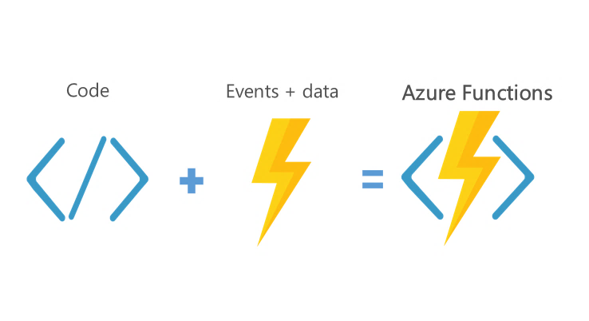
What is Azure Functions - FaaS

Slide 3

Key features of Functions
Choice of language
Pay-per-use pricing model
Bring your own dependencies
Integrated security
Simplified integration
Zero-downtime deployment
Open-source

Slide 4


Functions Triggers
HTTPTrigger
TimerTrigger
CosmosDBTrigger
BlobTrigger
QueueTrigger
EventHubTrigger
ServiceBusQueueTrigger
ServiceBusTopicTrigger
Custom Triggers

Slide 5
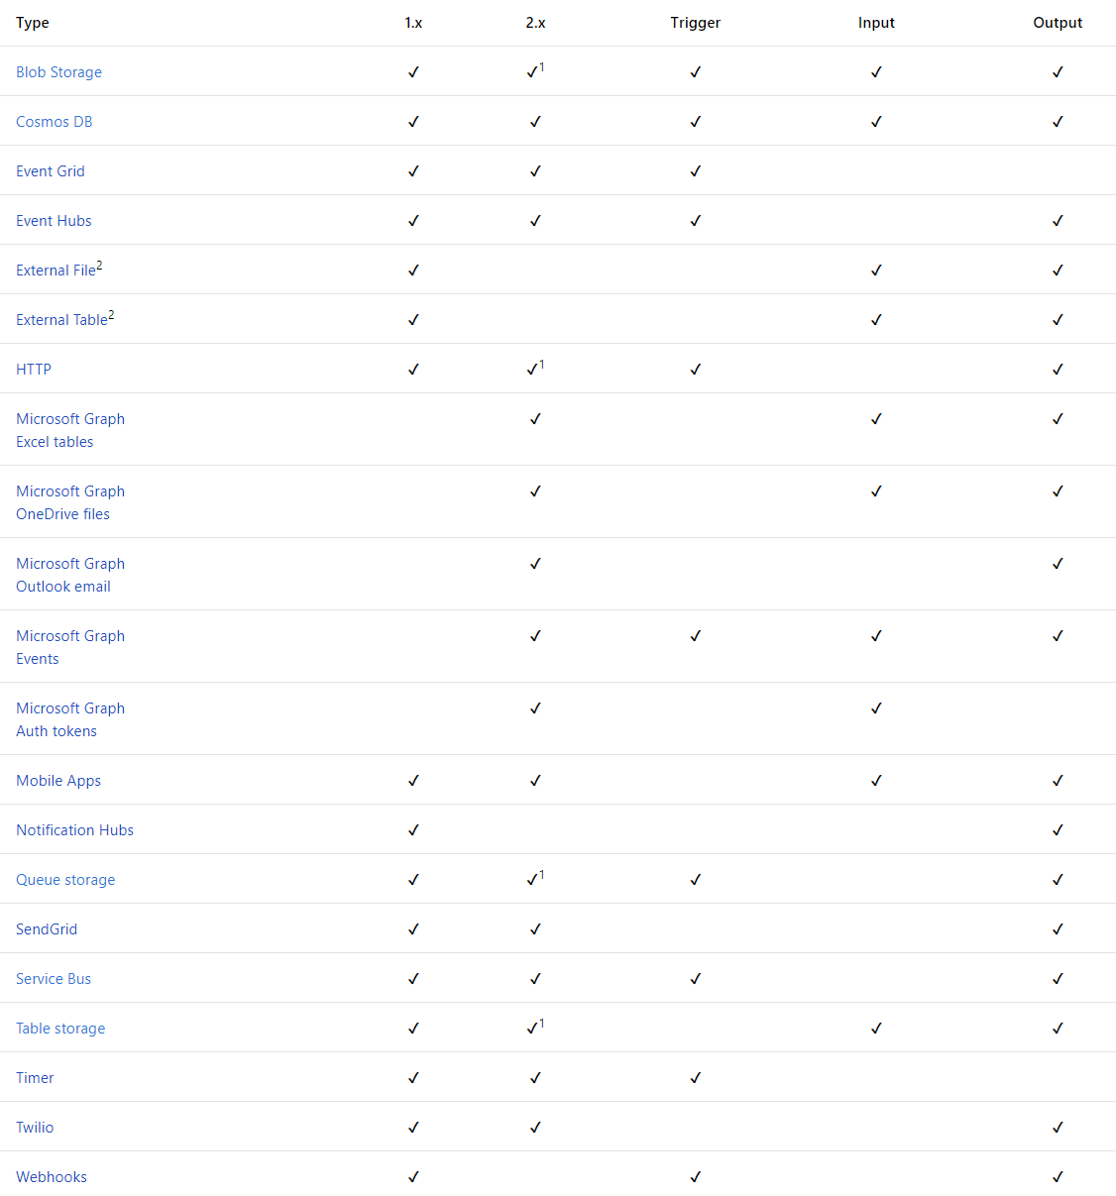

Slide 6
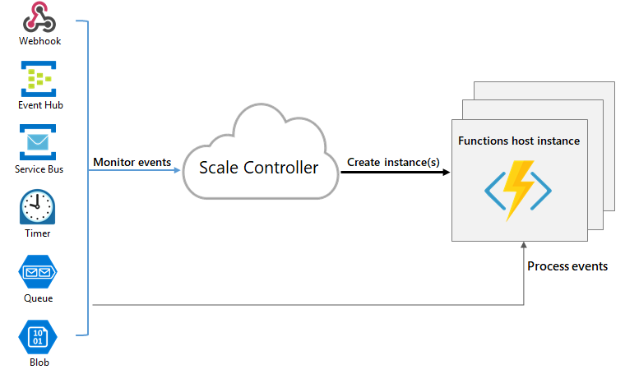
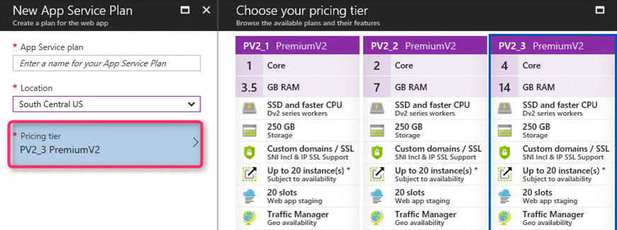
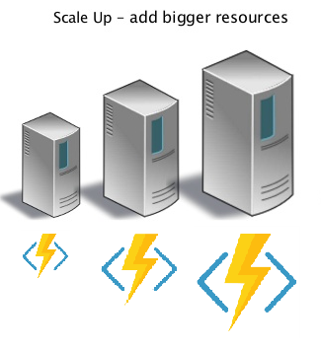
Pricing Model
Consumption plan
App Service plan

Slide 7
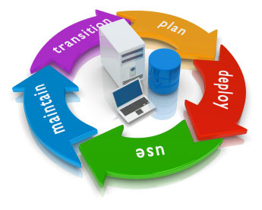
Deployment
Right click from Visual Studio
Deployment options in Azure portal
CI/CD using VSTS pipeline (Infrastructure as Code)

Slide 8

Limitations
15 seconds cold start
5 minutes timeout, max up to 10 minutes
10 seconds to scale out
200 instances max
1.5 GB RAM
1 Core

Slide 9
Questions?

Slide 10
Workshop Goals
Create a Functions App using Visual Studio
Deploy Functions App to Azure
Create Cosmos DB from Azure Portal
Integrate Functions with Cosmos DB using input & output binding
Prerequisites:
Visual Studio 2017 version 15.6
Azure Functions and Web Job Tools 15.0
Postman
https://github.com/bwwilliam/2018bootcamp
https://goo.gl/chzmA3

Slide 11
Emotions App
User
Web API
(POST)
Blob
Storage
Processor
(BlobTrigger)
Cognitive
Service
Web API
(Get)
Cosmos
DB
HTTP
Stream
Accepted
BlobTrigger
HTTP
JSON
JSON
HTTP
Binding
Document
JSON

Slide 12
Thank you!

